Slide 1

Geometry
Unit 2, Lesson 7 Proofs – Part 1 Volume 1, pg. 111

Slide 2


Benchmarks
MA.912.GR.1.1
Prove relationships and theorems about lines and angles. Solve mathematical and real-world problems involving postulates, relationships and theorems of lines and angles.
MA.912.GLT.4.10
Judge the validity of arguments and give counterexamples to disprove statements.
volume 1, pg. 111

Slide 3
Integrated Mathematical Thinking and Reasoning Standards
MA.K12.MTR.1.1 Actively participate in effortful learning both individually and collectively.
MA.K12.MTR.4.1 Engage in discussions that reflect on the mathematical thinking of self and others.
MA.K12.MTR.5.1 Use patterns and structure to help understand and connect mathematical concepts.
MA.K12.MTR.6.1 Assess the reasonableness of solutions.
volume 1, pg. 111

Slide 4

Learning Targets
I can relate deductive reasoning to completing proofs based on assumptions and given statements.
I can recognize paragraph, flow-chart, and two column proofs.
volume 1, pg. 111

Slide 5

Warm-Up
volume 1, pg. 112

Slide 6
2.7.1 Warm-Up: Miami Art Deco
A style known as Art Deco began in Paris in the mid-1920s. Art Deco buildings are characterized by their geometric shapes and symmetry. Two of the most famous examples of Art Deco architecture are the Empire State Building and Chrysler Building in New York City.
Photos of three locations in Miami that use this style of architectural design are shown.
volume 1, pg. 112

Slide 7
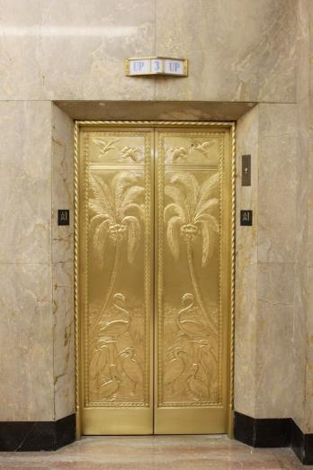
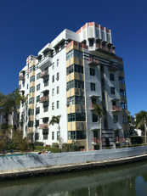
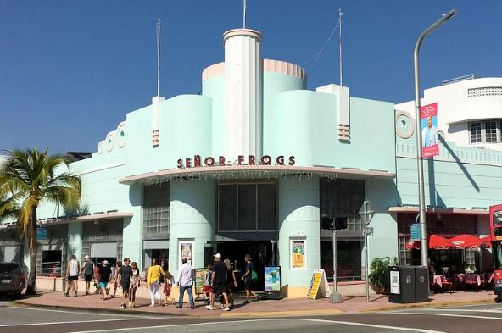
Draw a line of symmetry on each picture.
Which depiction of Art Deco do you find most interesting?
volume 1, pg. 112

Slide 8

Exploration
volume 1, pg. 112

Slide 9

2.7.2 Exploration: Proofs
A mathematical proof is an argument that shows something is true. A proof should begin with an assumption or a given statement.
A statement is given.
If two angles are supplementary to the same angle, then they are congruent to each other.
What is the hypothesis?
What is the conclusion?
volume 1, pg. 112

Slide 10
Draw a picture for the if-then statement.
The hypothesis is the given, or what is known to be true.
The conclusion will need to be shown, or proven, using deductive reasoning.
Discuss with your partner why inductive reasoning is not appropriate for this context. Summarize your discussion.
volume 1, pg. 112

Slide 11

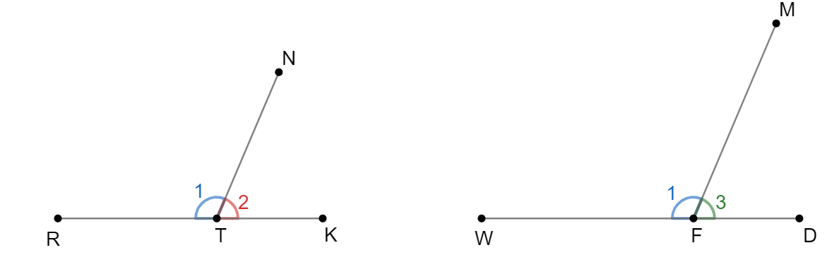
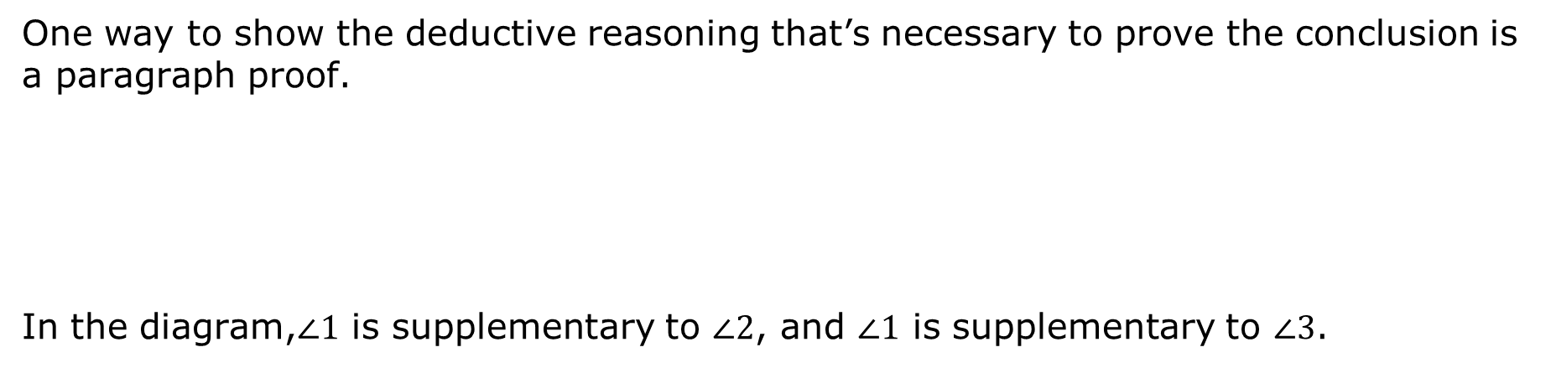
One way to show the deductive reasoning that’s necessary to prove the conclusion is a paragraph proof.
In the diagram,$∠1$ is supplementary to $∠2$, and $∠1$ is supplementary to $∠3$.
A paragraph proof is a narrative that gives the steps with justifications that prove a statement as true.
volume 1, pg. 113

Slide 12
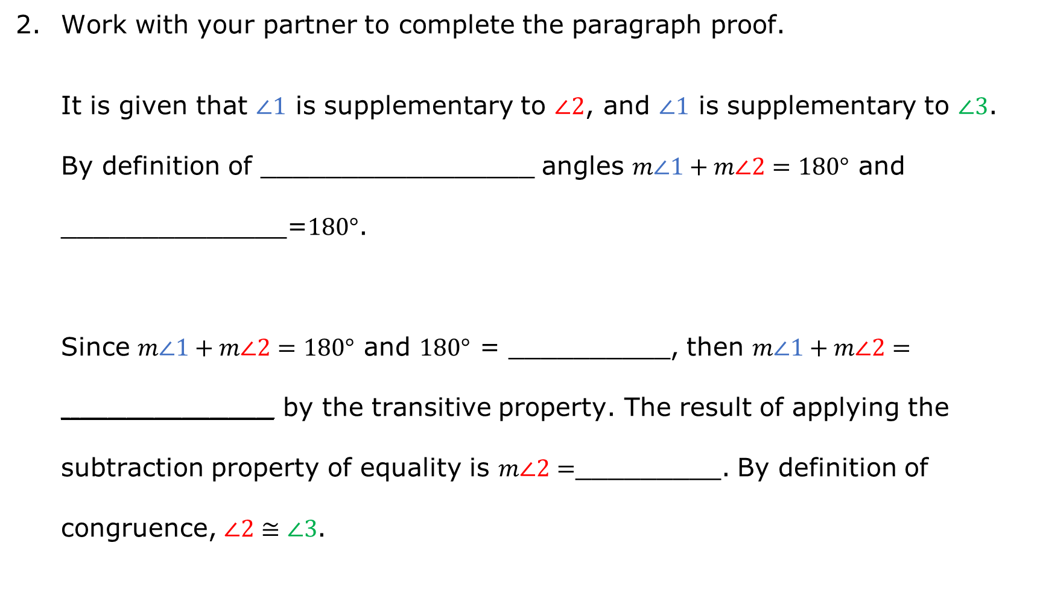
Work with your partner to complete the paragraph proof.
It is given that $∠1$ is supplementary to $∠2$, and $∠1$ is supplementary to $∠3$. By definition of _________________ angles $m∠1+m∠2=180°$ and ______________=$180°$.
Since $m∠1+m∠2=180°$ and $180°$ = __________, then $m∠1+m∠2=$ $_______________________$ by the transitive property. The result of applying the subtraction property of equality is $m∠2=$_________. By definition of congruence, $∠2≅∠3$.
volume 1, pg. 113

Slide 13
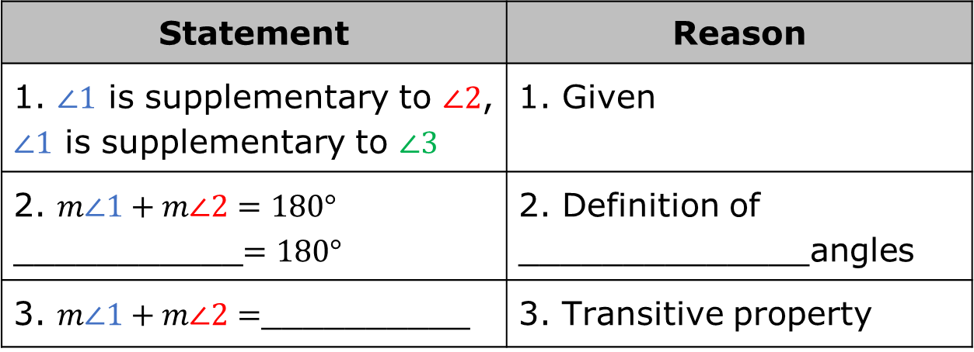
Another type of proof is the two-column proof.
Complete the two-column proof.
A two-column proof consists of two columns of a chronological list of steps, called statements, and justifications, called reasons.
Statement | Reason
1. $∠1$ is supplementary to $∠2$, $∠1$ is supplementary to $∠3$ | 1. Given
2. $m∠1+m∠2=180°$ ___________$=180°$ | 2. Definition of ______________angles
3. $m∠1+m∠2=$__________ | 3. Transitive property
volume 1, pg. 113

Slide 14

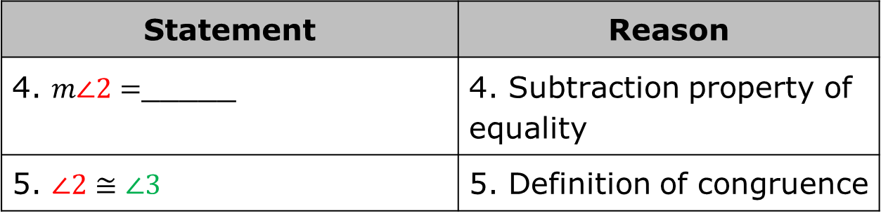
Statement | Reason
4. $m∠2=$_____ | 4. Subtraction property of equality
5. $∠2≅∠3$ | 5. Definition of congruence
If two figures have equal measurements, then by the definition of congruence, the figures are congruent. If congruence is shown through a series of transformations, then the definition of congruence in terms of rigid motions was applied.
volume 1, pg. 113

Slide 15
Discuss with your partner why the justification for step 5 is the definition of congruence. Summarize your discussion.
List similarities between the paragraph proof and the two-column proof.
A flowchart proof shows the structure of the proof using boxes and connecting arrows. The justifications are written beside or below the box.
volume 1, pg. 114

Slide 16
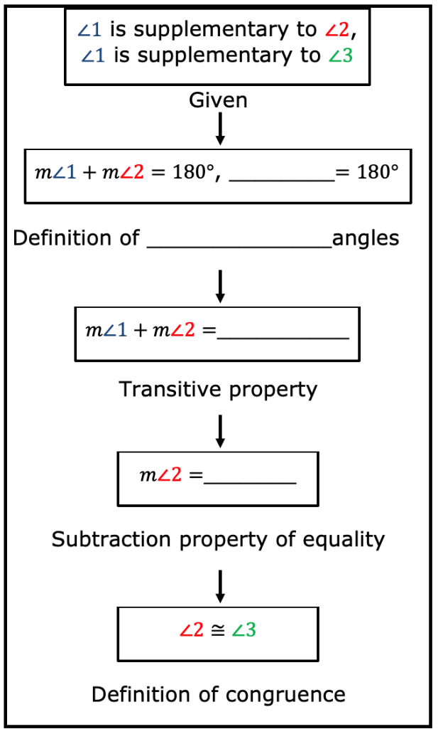
Complete the flowchart proof
Which of the three types of proofs did
you find the easiest to follow?
volume 1, pg. 114

Slide 17

Guided Instruction
volume 1, pg. 115

Slide 18
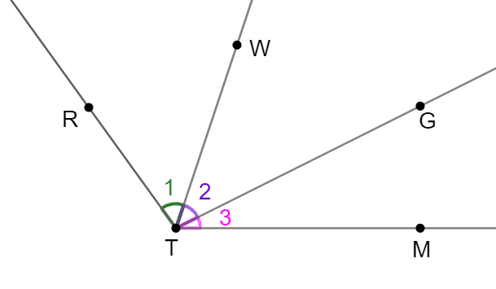
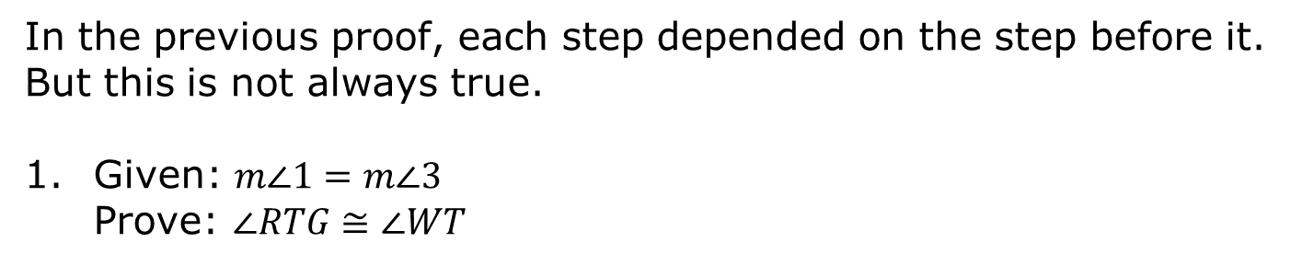
2.7.3 Guided Instruction: Flow Chart Proof
In the previous proof, each step depended on the step before it. But this is not always true.
Given: $m∠1=m∠3$
Prove: $∠RTG≅∠WT$
volume 1, pg. 115

Slide 19
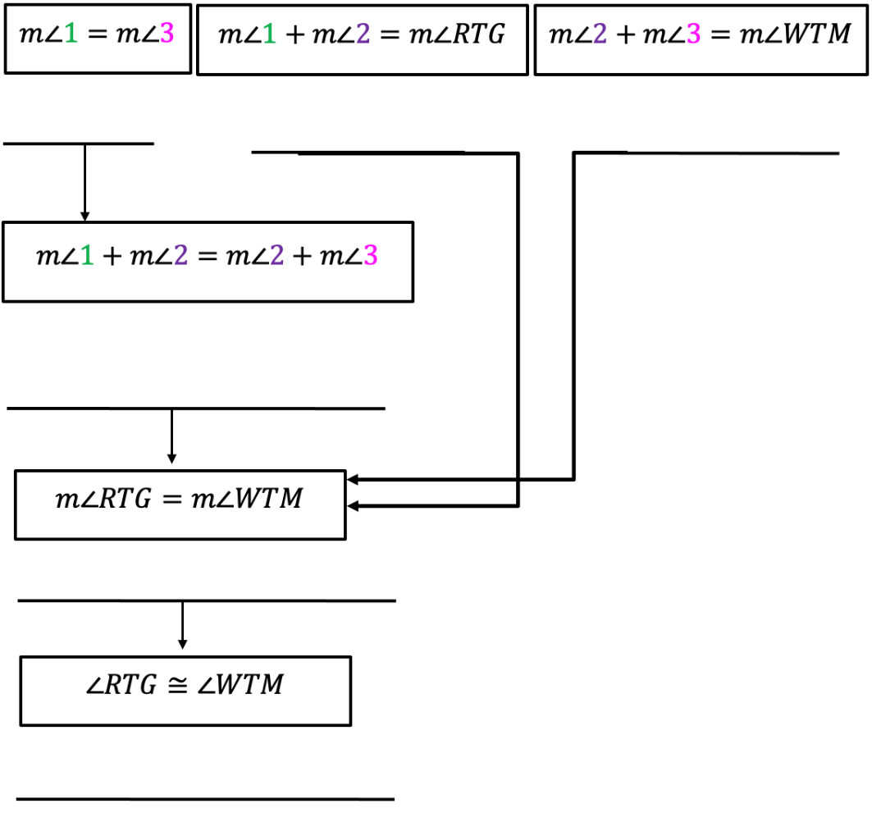
volume 1, pg. 115

Slide 20

Guided Practice
volume 1, pg. 115

Slide 21

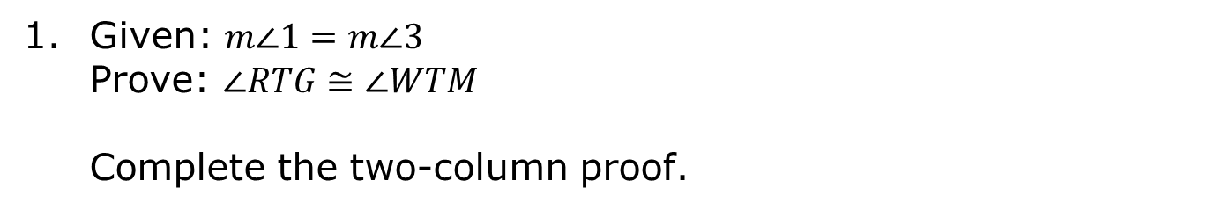
2.7.4 Guided Practice: Two-Column Proof
Given: $m∠1=m∠3$
Prove: $∠RTG≅∠WTM$
Complete the two-column proof.
volume 1, pg. 115

Slide 22
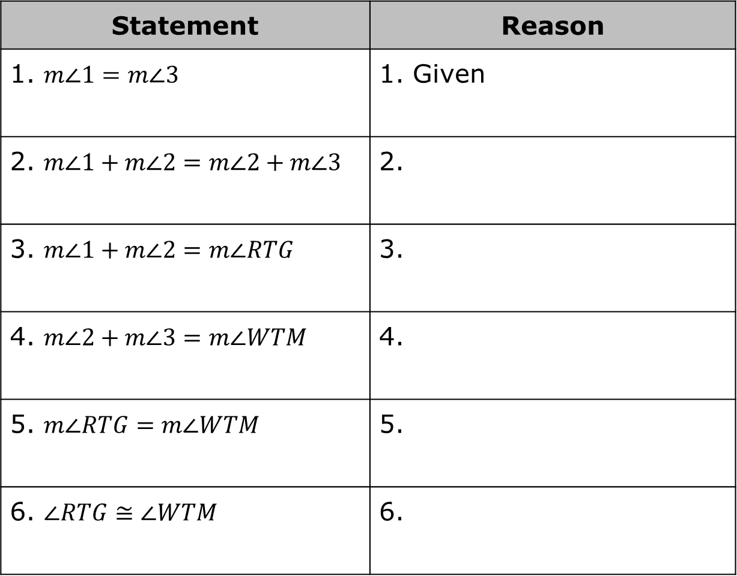
Statement | Reason
1. $m∠1=m∠3$ | 1. Given
2. $m∠1+m∠2=m∠2+m∠3$ | 2.
3. $m∠1+m∠2=m∠RTG$ | 3.
4. $m∠2+m∠3=m∠WTM$ | 4.
5. $m∠RTG=m∠WTM$ | 5.
6. $∠RTG≅∠WTM$ | 6.
volume 1, pg. 115

Slide 23

Wrap-Up
volume 1, pg. 116

Slide 24
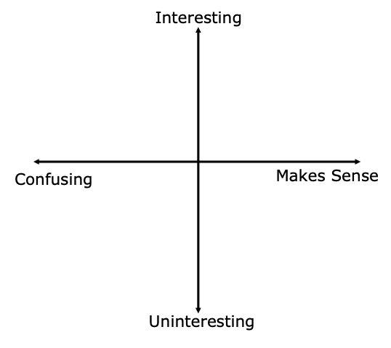
2.7.5 Wrap-Up: Reflection
Plot a point in one of the quadrants below to indicate how you feel about today’s lesson.
volume 1, pg. 116

